Slide 1
AUTO TEMPARATURE AND FACE MASK SCANNING SYSTEM
Project review 1
Team no. 28
TEAM MEMBERS:
LAIPHRAKPAM RISHIKANTA SINGH
PERURI ASRITH
ADARSH KUMAR GUPTA

Slide 2
INDEX
Problem statement
Components used
Block diagram
Circuit diagram
CIRCUIT CONNECTION
Code part
Applications
Future scope

Slide 3
AUTO TEMPERATURE AND FACEMASK SCANNING SYSTEM
Problem statement
In these trying times, due to the covid pandemic, we are at a lot at risk of exposer to covid19, especially in public places. So, when we enter public places like train stations, airports, offices or an amusement park, we need to check if they are not showing covid symptoms and wearing masks at all times. But we need extra personal to check each person of body temperature. But sometimes manual scanning is disadvantageous. The personnel are not well trained on using temperature scanner devices. There is human error in reading values. Many a times people are not barred from entry even after higher temperature readings or no masks.
To solve this problem, we here propose a fully automated temperature and facemask scanner and entry provider system. The system makes use of a temperature scanner and a mask monitor. The scanner is connected directly with a human barrier to bar entry if high temperature or no mask is detected.
Any person will not be provided entry without temperature and mask scan. Thus, the system provides a 100% automated system to prevent the spread of COVID.

Slide 4
COMPONENTS USED
Arduino uno
16 X 2 l2C LCD DISPLAY
E18-D80NK Adjustable IR Sensor
green and red LED
Servo motor
Lm2596 adjustable dc-dc controller
9v battery
Esp32-CAM WIFI
CH340G USB to TTL serial converter
Resistors(1k)
Jumper wires

Slide 5
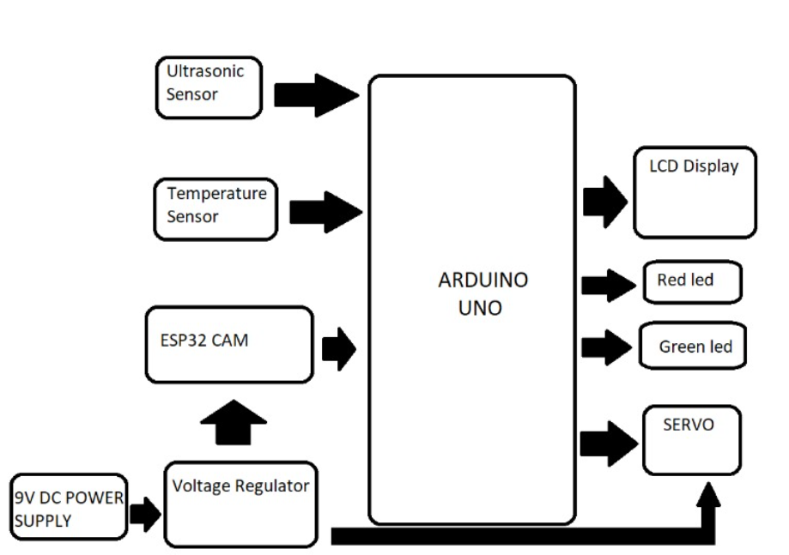
BLOCK DIAGRAM

Slide 6
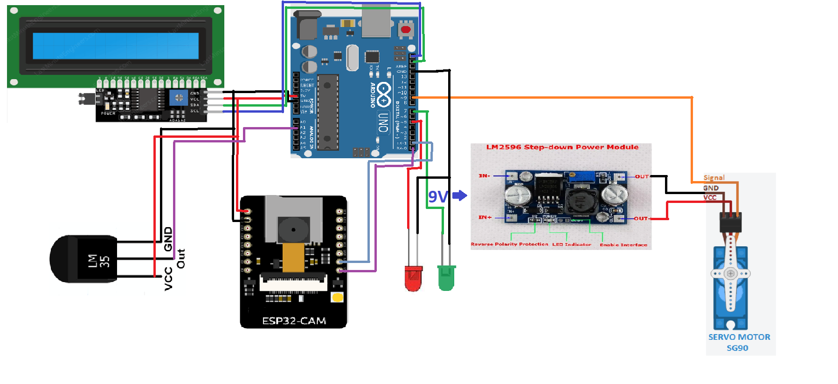
CIRCUIT DIAGRAM

Slide 7
CIRCUIT CONNECTIONS
ESP-32
USB-TTL
Laptop
5v ---------→ 5v
GND ---------→ GND
TX ---------→ UORXD
RX ---------→ UOTXD

Slide 8
CIRCUIT CONNECTIONS
Tools
Board
Esp-32 Arduino
ESP-32 wrover module
Tools:
Upload speed:921600
Flash Frequency: 80 MHZ
Flash mode: QIO
Partition Selection: Huge App
Tools
Port
Select Port

Slide 9
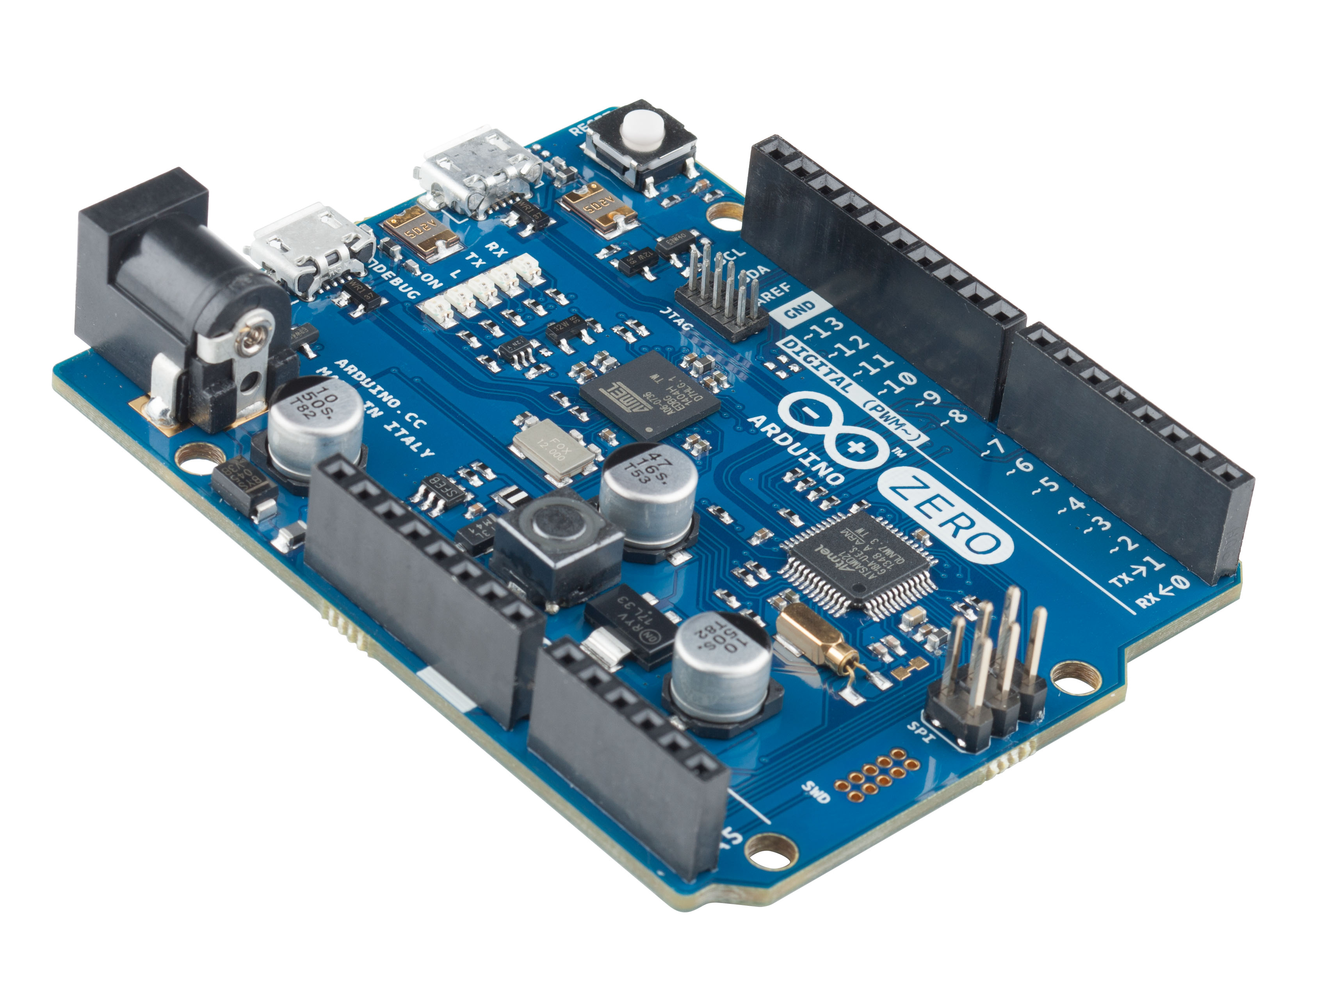
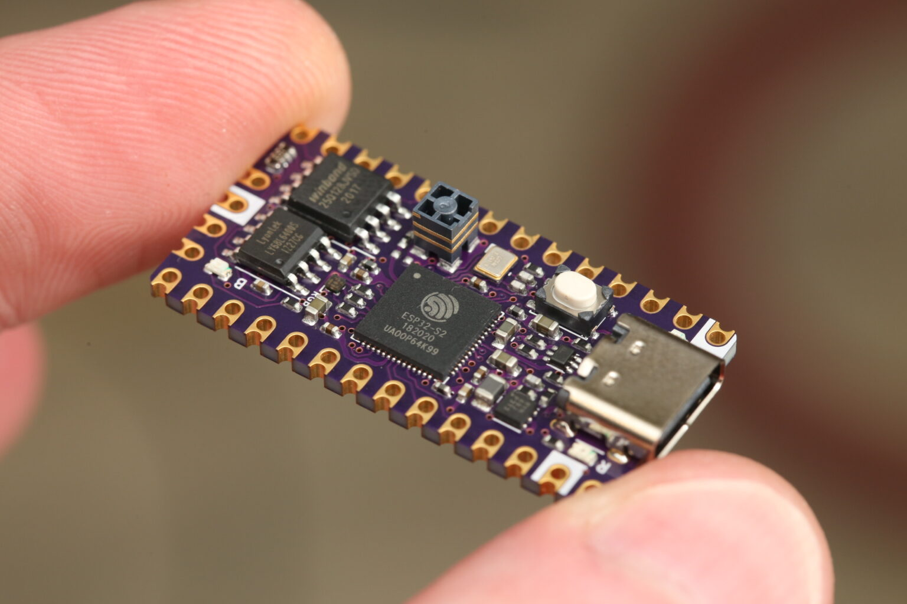
CIRCUIT CONNECTIONS
Connections of all components:
Arduino ESP-32
5V -------------→ 5V
GND -------------→ GND
TX -------------→ UORXD
RX -------------→ UOTXD
Arduino LCD
5V -------------→ 5V
GND -------------→ GND
SDA -------------→ SDA
SCL -------------→ SCL

Slide 10
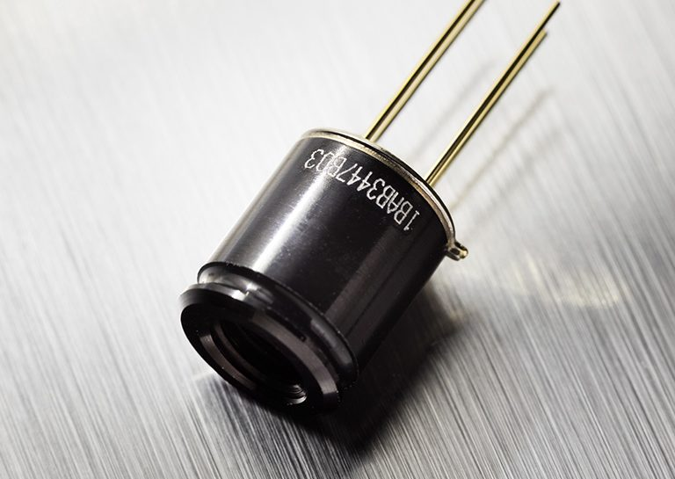
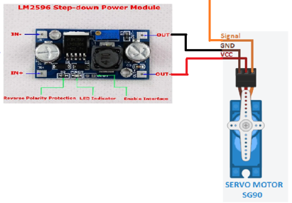
CIRCUIT CONNECTIONS
Arduino IR-Sensor(Temp Sensor)
5V -------------→ 5V
GND -------------→ GND
A1 -------------→ Signal
To pin ~9
9V Battery
L2596 module Servo
Out+ -------------→ Vcc wire
Out- -------------→ GND wire

Slide 11
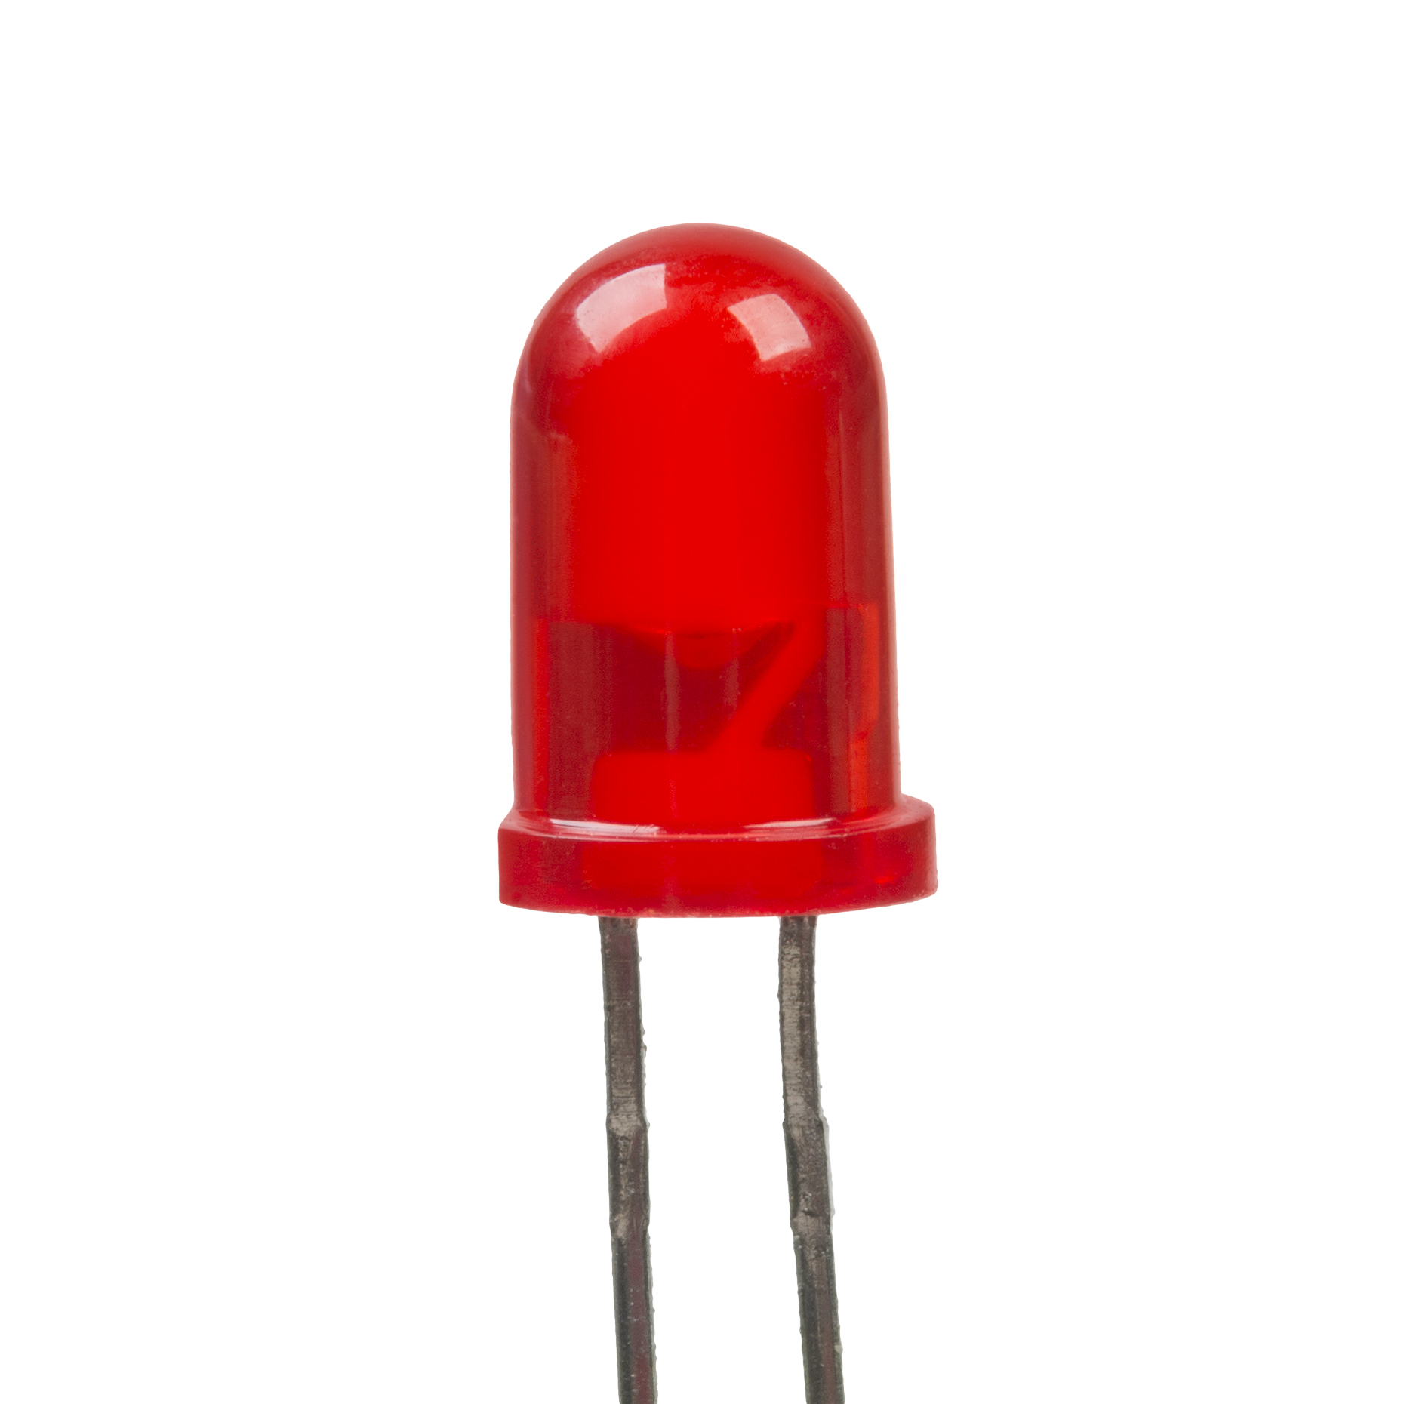
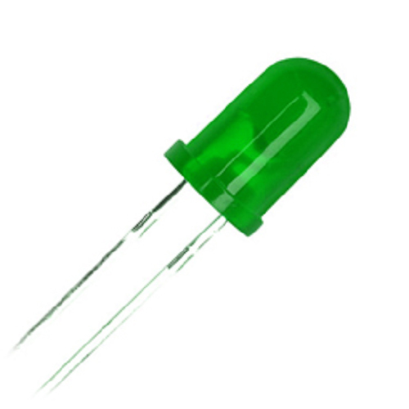
CIRCUIT CONNECTIONS
Arduino Red LED
Red LED -------------→ pin ~7
Green LED -------------→ pin ~5

Slide 12
CODE PART
ARDUINO SOURCE CODE
void loop()
{
char szData[30];
unsigned short usExit = 0;
unsigned short usData_Len = 0;
unsigned short usIsNeed_Rescan = 0;
short sMask_Percent = 0;
if(digitalRead(IR_SENSOR_PIN) == ON)
{
if(gusIsSensor_Detect_Bef == 0)
{
vDisp_Scanning();
memset(szData, '\0', sizeof(szData));
do
{
if(digitalRead(IR_SENSOR_PIN) == ON)
{
if(gusIsSend_Request == 0)
{
Serial.println(START_RUN); //send request to ESP32-CAM to scan face
gusIsSend_Request = 1;
}
When IR ssensor is active, Arduino will send a request to ESP32 to run face detection algorithm

Slide 13
AUTO TEMPERATURE AND FACEMASK SCANNING SYSTEM
ESP32 CAM SOURCE CODE
memset(szData, '\0', sizeof(szData));
if(usRead_Serial_Data(szData, sizeof(szData)) > 0) //read data request from Arduino
{
if(szData[0] == START_RUN) // start face_detection algorithm
{
gusIsStart = 1;
gusRestart_Scan = 0;
gusFrame_Count = 0;
}
else if(szData[0] == RESTART_ESP32) // restart ESP32-CAM in case of ESP32-CAM hung up
{
ESP.restart();
}
Then ESP32 CAM start face detection algorithm.
It can start offline or online while streaming
A yellow box on the face means face is detected
That means that person is not wearing a mask
When wearing a mask, no face is detected meaning that person is wearing a mask.

Slide 14
AUTO TEMPERATURE AND FACEMASK SCANNING SYSTEM
ESP32 CAM SOURCE CODE
if(gusFrame_Count >= NUM_FRAME) // scanning for 10 times
{
for(short i=0; i<NUM_FRAME; i++)
{
if(gsArrayIsFaceDetect[i] == 0)
{
sNum_Detect++; // number of face not detected
}
}
sPercent_Wear_Mask = map(sNum_Detect, 0, NUM_FRAME, 0, 100); //calculate the percentage of face not detected
if(gusRestart_Scan == 1)
{
Serial.println('\0');
}
else
{
memset(szTemp, '\0', sizeof(szTemp));
sprintf(szTemp, "*%d,",sPercent_Wear_Mask);
Serial.println(szTemp); //send percentage number to Arduino
}
gusFrame_Count = 0;
gusIsStart = 0;
}
}
After completing 10 scans, ESP32 CAM will calculate the percentage of face not detected and send it to Arduino.
LCD will display the percentage of face not detected(or mask detected)

Slide 15
AUTO TEMPERATURE AND FACEMASK SCANNING SYSTEM
ARDUINO SOURCE CODE
Serial.println(START_RUN); //send request to ESP32-CAM to scan face
gusIsSend_Request = 1;
}
usData_Len = usRead_Serial_Data(szData, sizeof(szData)); //Read data from ESP32-CAM
if(usData_Len > 0)
{
if(szData[0] == '*')
{
sscanf(szData, "*%d,", &sMask_Percent);// ESP32-CAM will return mask percent to Arduino
usIsNeed_Rescan = 0;
gusIsSend_Request = 0;
usExit = 1;
}
}
} ESP.restart();
}
Arduino will receive the percentage value from ESP32CAM.
Then it will open or close the door based on the percentage value

Slide 16
AUTO TEMPERATURE AND FACEMASK SCANNING SYSTEM
ARDUINO SOURCE CODE
if(usIsNeed_Rescan == 0)
{
vLCD_Disp_Status(sMask_Percent);
if(sMask_Percent >= MASK_DETECT_TH) //if the percentage is higher than MASK_DETECT_TH (80%), door will open
{
vLED_Control(SCAN_PASS);
vServo_Control(OPEN_DOOR);
delay(OPEN_DOOR_TIME);
vServo_Control(CLOSE_DOOR);
delay(CLOSE_DOOR_TIME);
}
else
{
vServo_Control(DOOR_LOCK);
vLED_Control(SCAN_ERROR);
delay(1000);
}
}
If the percentage of mask detected is higher than 80%(considering some error), door will open.

Slide 17
APPLICATIONS
Railways
Airport entry
Offices entry
Museums and amusement parks
Other public places

Slide 18
ADVANTAGES AND DISADVANTAGES
Advantages:
Full automatic detection
Automatic operation without any human interventions
Disadvantages:
Heavy load on servo
Face detection algorithm is not the best

Slide 19
FUTURE SCOPE
Use improved facecam modules for better detection
Improved interaction using better interfaces instead of LCD
Use better IR non contact temperature sensor for better accuracy at distance
Adding features to store data about people suspected with covid and uploading to official clouds

Slide 20
CONTRIBUTION
LAIPHRAKPAM RISHIKANTA SINGH : SUGGESTING PROJECT IDEAS,RESEARCH AND LEARNING CODINGS, CODING IN ARDUINO AND ESP32, SHOPING AND FINDING COMPONENTS, MAKING CIRCUITDIAGRAMS AND BLOCK DIAGRAMS
PERURI ASRITH: SUGGESTING PROJECT IDEAS,RESEARCH AND COMPONENTS CONNECTION, SHOPING AND FINDING COMPONENTS, DESIGNING AND FORMATING OF PPT.
ADARSH KUMAR GUPTA: SUGGESTING PROJECT IDEAS,RESEARCH AND COMPONENTS CONNECTION, WIRING, DESIGNING AND MAKING PPT.

Slide 21
THANK YOU

